Slide 1


Watch Dogs
Bodhi Manandhar, 331947
Sambodhi Manandhar, 331960
Sandip Khadha, 331961

Slide 2

​​​Contents / Agenda
Introduction
Problem Statement
Motivation
Features & Block Diagram
Objectives & Flowchart
Platform
(Development environment)
Circuit Diagram & Gantt Chart
Conclusion

Slide 3

Introduction
Watch dogs is a home security system using 8051 microcontroller
The system is built using 16x2 LCD, keypad ,GSM module, H bridge L298N, BJT(BC547) and DC motor
The system has password operated DC motorized door lock and unlock system
If system detects 3 wrong password attempts, then SMS alert will be sent to the owner and a cooldown is implemented

Slide 4
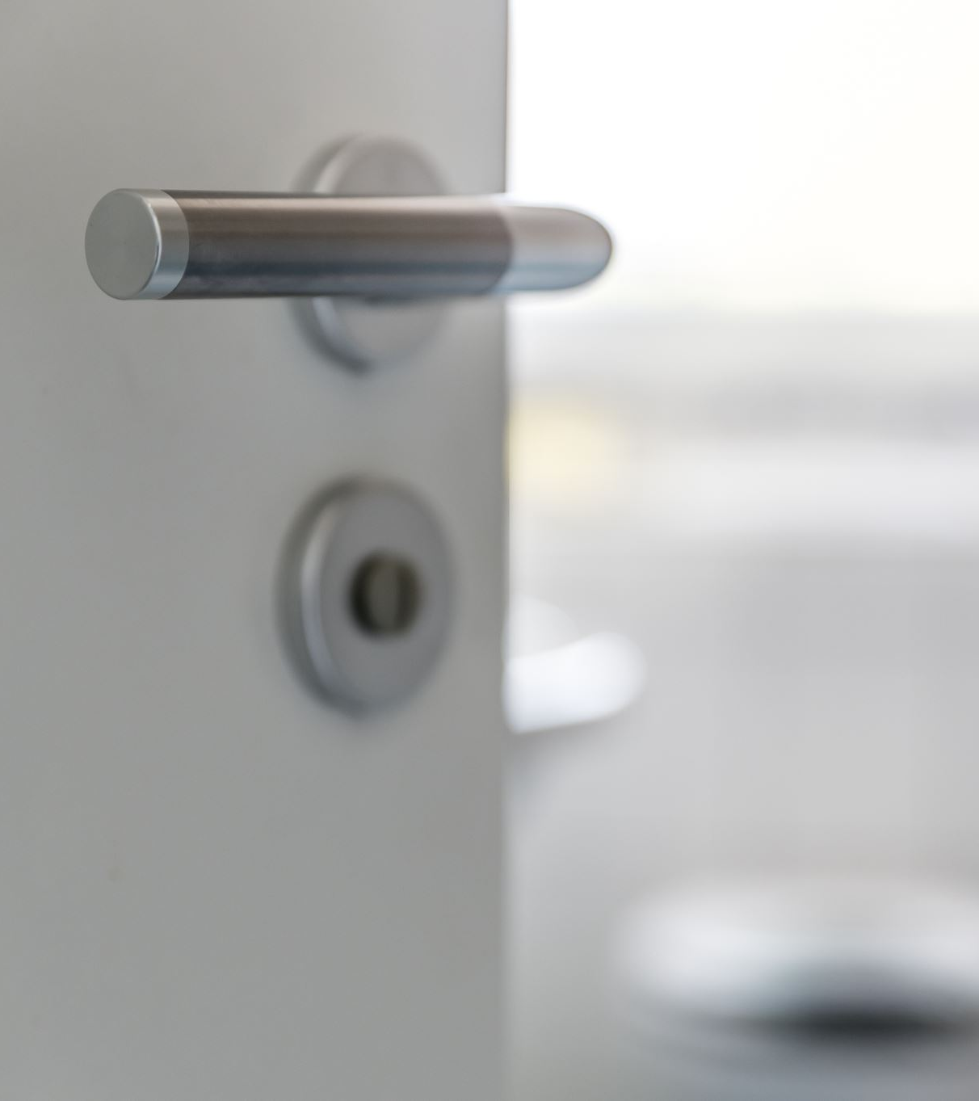

Problem Statement
->Easy to use security device
-> Rising incidents of unauthorized access and intrusion

Slide 5
Features
Simple yet affordable security measures.
To implement hardware project Automated effortless security

Slide 6
Features
Password door lock and unlock system
Sends SMS alert to the owner after three wrong password attempt

Slide 7
Objective
To design cost effective security solution​
To enhance security​
To drive individual and organization with ability to enhance security for their property
7
7

Slide 8
​​​Platform/Dev Environment
Microcontroller : 8051 family
For polarity: H bridge l298n
For Switch: BJT
Alarm System and DC motor
Embedded Development tool :Keil V5
Electronic Design tool :Proteus
8
8

Slide 9
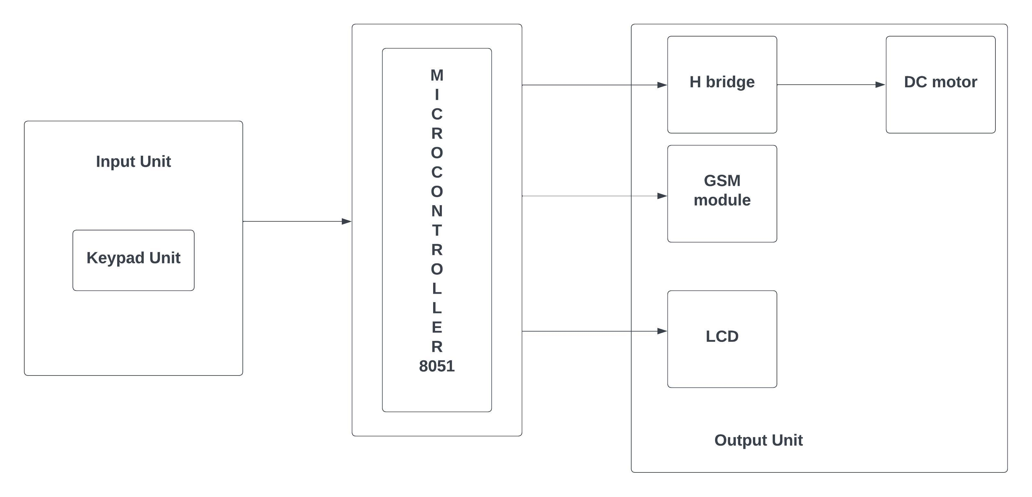
​​​Block Diagram

Slide 10
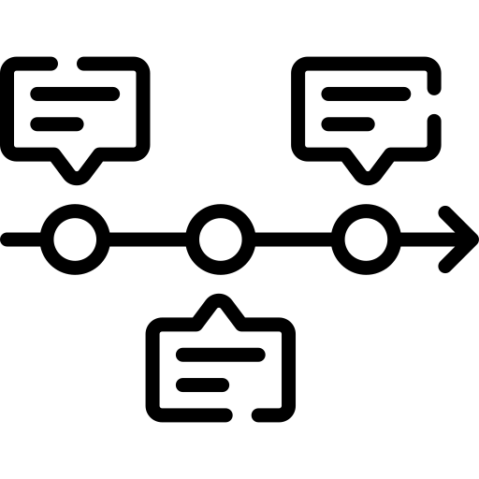
​​​Planned Timeline
Planning
1
2
3
4
5
6
7
8
9
10
11
12
Design & Analysis
Coding & Simulation
Hardware and Assembly
Testing
Documentation
LOREM

Slide 11

​​​Conclusion
It uses keypad as input unit
8051 is used as main processing unit
LCD GSM module,DC motor as output unit
H bridge and BJT for higher output voltage

